Slide 1
Seattle, WA terry stops
Phase 3 Project
Shamla Araya
DSF-PT07P3

Slide 2

intro
What is Terry Stop?
In Seattle, Terry stops refer to brief stops and detentions by police officers based on a reasonable suspicion that a person may be involved in criminal activity. The term originates from the U.S. Supreme Court case Terry v. Ohio (1968), which established the legal standard for such stops. In Seattle, these stops are subject to both federal and local regulations, and there has been considerable debate over their impact on communities, particularly concerning concerns about racial profiling and civil liberties. Efforts to refine and improve the practice focus on balancing effective policing with the protection of individual rights.

Slide 3


The Goal
In this project we aim to achieve the following objectives:
Determine if there is a racial disparity in the Seattle Terry Stops
Do the differences in races between the officer and the subject play a role in frisks arrests?
Determine the most common outcome of the Seattle Terry Stops and what it means
Develop a model that can accurately predict the likelihood of an arrest occurring during a Terry Stop

Slide 4

The Process
This project is divided into three workbooks, each focusing on a specific aspect of the process. We started by exploring the data and cleaning, followed by exploratory analysis aiming to address the first three objectives which are racial disparity during Terry Stops, role of race in the Terry Stops and the most common outcome of the Terry Stops in Seattle. We will then move on to the third workbook where we will be addressing the fourth objective of developing a comprehensive predictive model that can accurately predict the likelihood of an arrest following a Terry Stop based on various factors. In this project we will be using the data obtained from City of Seattle on https://data.seattle.gov/Public-Safety/Terry-Stops and the population data was obtained from https://worldpopulationreview.com/us-cities/washington/seattle
Part 1: Observing and cleaning the Data
Part 2: Exploratory Data Analysis on Seattle Terry Stops
Part 3: Seattle Terry Stops Modeling

Slide 5
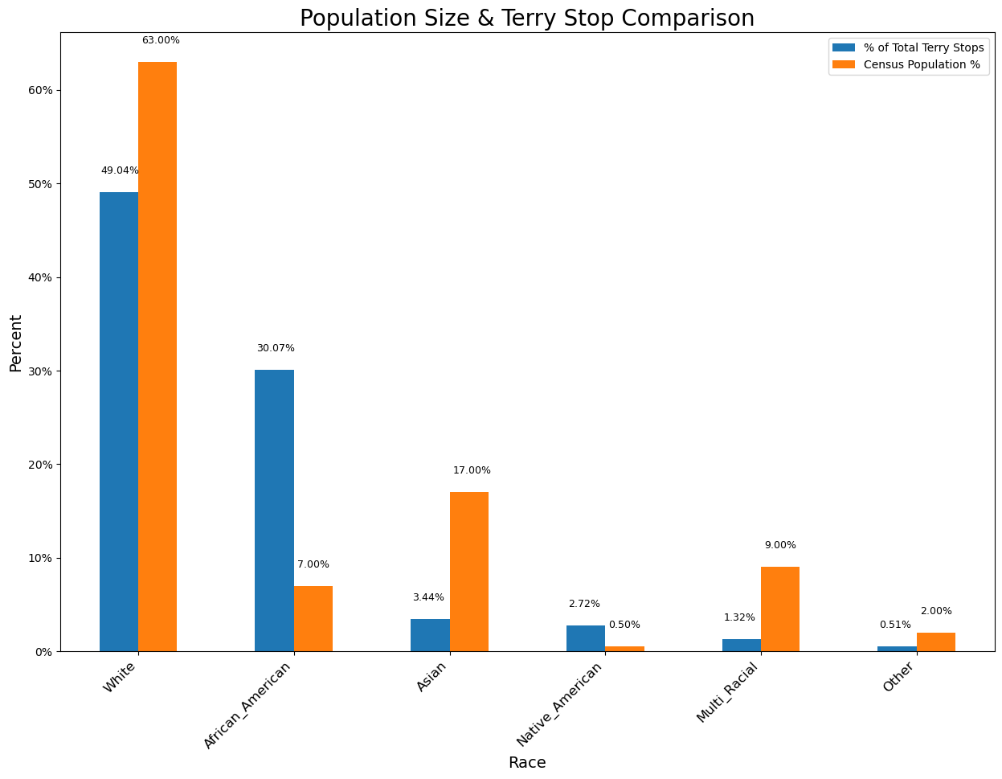
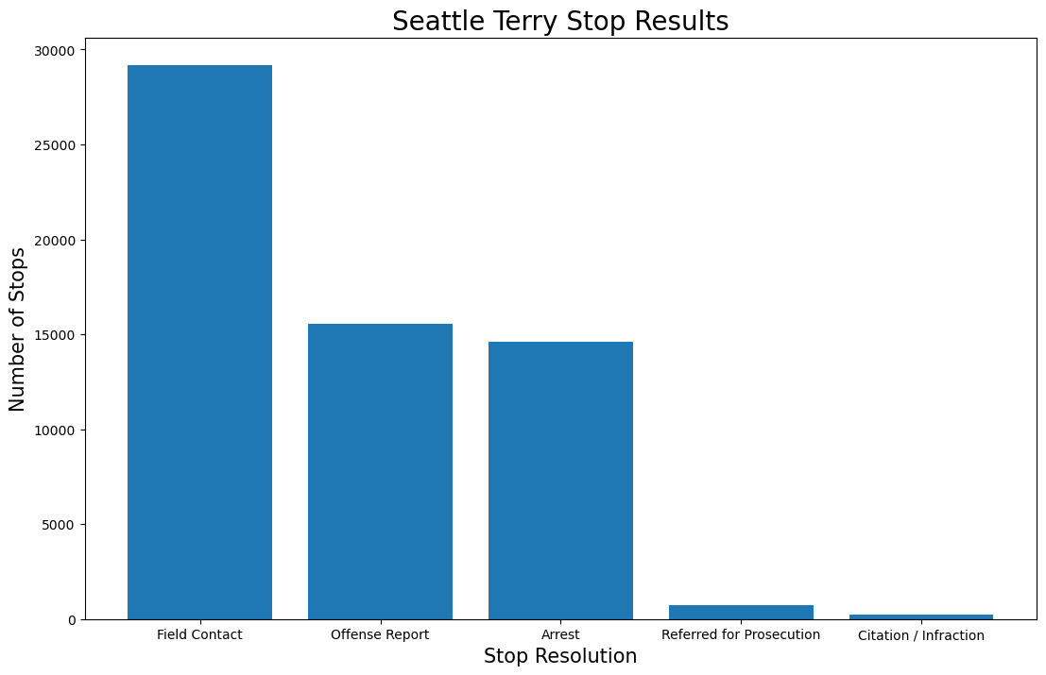
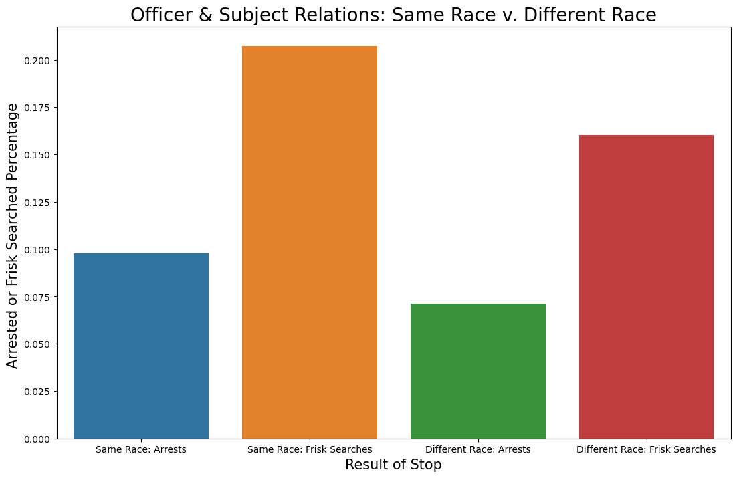
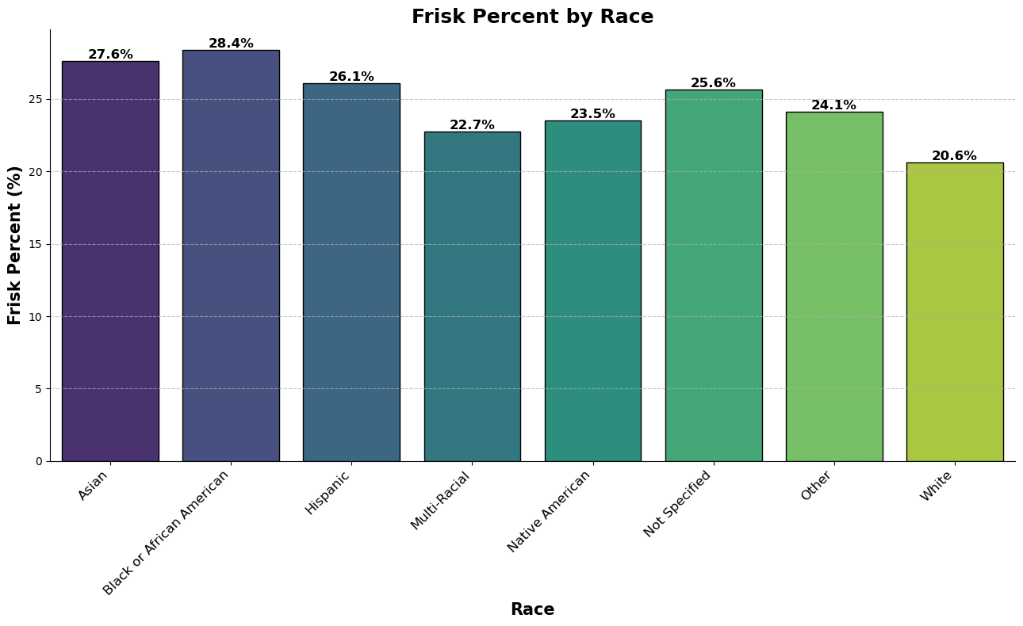
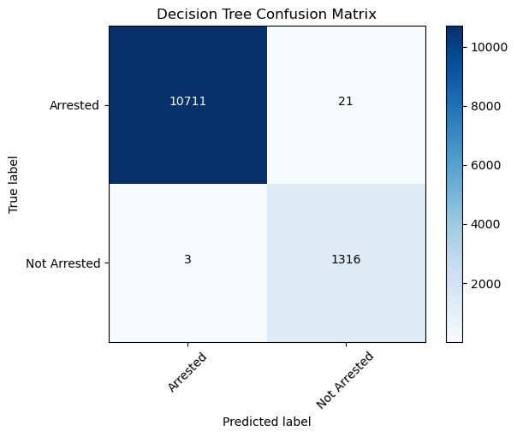
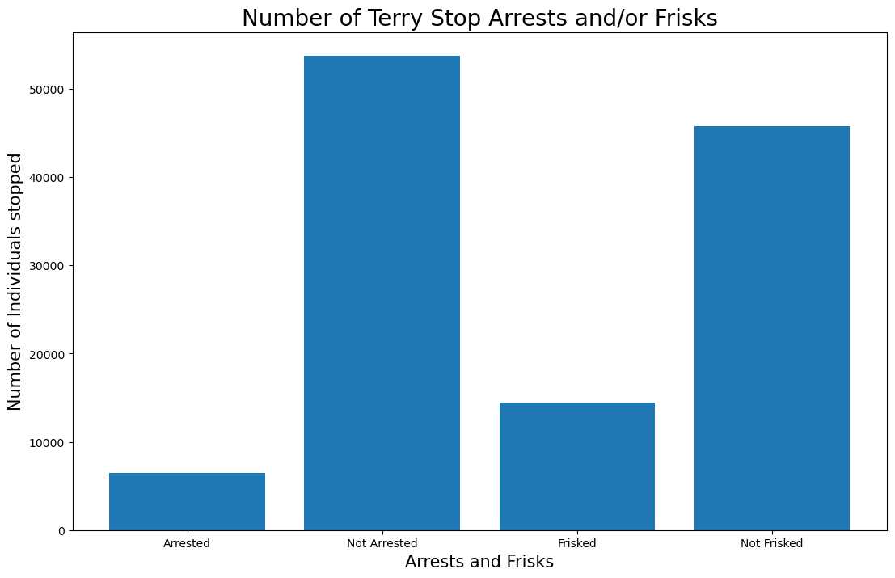
The findings
This project has identified the following findings:
African Americans experience 30% of Terry stops despite being only 7% of the population suggests a significant racial disparity in policing. This indicates potential biases in police practices.
African Americans, while experiencing fewer overall Terry stops compared to White individuals, are subject to frisks more frequently when stopped. This disparity could indicate potential racial bias or differing police practices that result in more invasive procedures for African Americans.
A large gap between the number of people frisked and the number of arrests.
Officers exhibiting higher frisk and arrest frequencies towards individuals of their own race compared to those of a different race.
The prevalence of "Field Contact" as the most common outcome of the Terry stops in Seattle
Best Model: Based on the outcome of the function we defined to identify the best model though we are concluding that the Decision Tree Model is the best performing one to be recommended.

Slide 6
Recommendations
Based on the findings we recommend the following steps:
Address Racial Bias: Implement anti-bias training, revise stop policies for fairness, and increase transparency through audits and public reporting.
Reform Frisk Practices: Review frisk criteria to ensure they are justified and applied fairly, minimizing racial profiling.
Evaluate Effectiveness: Assess and adjust stop-and-frisk practices to improve outcomes and build community trust.
It is important to implement anti-bias training, review policing policies, and ensure equitable enforcement practices. Additionally, engaging with communities and improving data collection can help address and mitigate these disparities.
Optimize Field Contacts: Ensure field contacts are constructive and aligned with policing goals to enhance effectiveness and community engagement.
By analyzing and predicting Terry stops in Seattle, law enforcement officers and community members can make informed decisions about when and where to stop individuals, address the identified issues and concerns, and improve the overall effectiveness of their policing efforts.

Slide 7
The End

